Slide 1
DATA WAREHOUSING
By
Syed Bakhtawar Shah Abid
Assistant Professor
Department of Computer Science
Data Warehousing

Slide 2
DENORMALIZATION
Denormalization is an approach for speeding up read-oriented data retrieval performance in a relational database, where the database administrator selectively adds back specific instances of redundant data after the data structure has been normalized.
A denormalized database should not be confused with a database that has never been normalized.
Data Warehousing

Slide 3
DENORMALIZATION
Using normalization in SQL, a database will store different but related types of data in separate logical tables, called relations.
When a query combines data from multiple tables into a single result table, it is called a join.
The performance of such a join in the face of complex queries is often the occasion for the administrator to explore the denormalization alternative.
Data Warehousing

Slide 4
DENORMALIZATION
The process of adding redundant data to get rid of complex join, in order to optimize database performance.
This is done to speed up database access by moving from higher to lower form of normalization.
De-normalization is the process of attempting to optimize the performance of a database by adding redundant data.
It is used to introduce redundancy into a table in order to incorporate data from a related table.
The related table can then be eliminated.
De-normalization can improve efficiency and performance by reducing complexity in a data warehouse schema.
Data Warehousing

Slide 5
NORMALIZATION VS DENORMALIZATION
Multiple joins in the same query can have a negative impact on performance.
As the number of tables spawned by the design increases, the complexity of the joins can create computing overhead that is unacceptable.
Joins can be I/O intensive, and related query execution can consume an inordinate amount of time, sometimes even crashing applications.
Data Warehousing

Slide 6
NORMALIZATION VS DENORMALIZATION
With database denormalization, data designers stitch together disparate tables.
This happens at the expense of a number of data redundancies, but it can be useful for cutting down on the number of joins, and thus speeding operations.
The trade-off for the database designer lies in creating database systems that have fewer large tables or more small tables, based on resources and requirements for interactivity of queries.
The designer must also weigh this against problems of data redundancy, especially the possibility of increased data inconsistency.
Data Warehousing

Slide 7
NORMALIZATION VS DENORMALIZATION
After data has been duplicated, the database designer must take into account how multiple instances of the data will be maintained.
One way to denormalize a database is to allow the database management system to store redundant data on disk.
This has the added benefit of ensuring the consistency of redundant copies. As disk costs have fallen over the years, such approaches have grown in popularity.
Makers of relational databases have enhanced databases to ensure better consistency when denormalization is employed.
Data Warehousing

Slide 8
NORMALIZATION VS DENORMALIZATION
One of the approaches to denormalization is to denormalize the actual logical data design.
This can quickly lead to inconsistent data.
Rules called constraints can be used to specify how redundant copies of information are synchronized, but they increase the complexity of the database design and also run the risk of impacting write performance.
Data Warehousing

Slide 9
NORMALIZATION VS DENORMALIZATION
Common cases where denormalization may effectively be used include
  Pre-joined tables that package data for common uses,
  Split tables tailored for specific user groups and
  Combined tables that consolidate one-to-one and one-to-many relationships.
Data Warehousing

Slide 10
NORMALIZATION VS DENORMALIZATION
In relational data warehouses, denormalization often plays an important role.
This is particularly true in dimensional databases as prescribed by influential data warehouse architect and author Ralph Kimball.
His emphasis on dimensional structures that use denormalization is intended to speed query execution, which can be especially important in data warehouses used for business intelligence.
Denormalization helps data warehouse administrators ensure more predictable performances.
Data Warehousing

Slide 11
NORMALIZATION VS DENORMALIZATION
There should be a balance between normalized and de-normalized forms.
In a fully normalized form, too many joins are required and in a totally de-normalized form, we have a big, wide single table.
Database should be aligned someplace in between so as to strike a balance, especially in the context of the queries and the application domain.
Data Warehousing

Slide 12
NORMALIZATION VS DENORMALIZATION
A “pure” normalized design is a good starting point for a data model and is a great thing to do and achieve in academia.
However, in the reality of the “real world”, the enhancement in performance delivered by some selective de-normalization technique can be a very valuable tool.
The key to success is to undertake de-normalization as a design technique very cautiously and consciously.
Do not let proliferation of the technique take over your data warehouse or you will end up with a single big flat file!
Data Warehousing

Slide 13
NORMALIZATION VS DENORMALIZATION
De-normalization is the process of selectively transforming normalized relations into un-normalized physical record specifications, with the aim of reducing query processing time.
Another fundamental purpose of denormalization is to reduce the number of physical tables that must be accessed to retrieve the desired data by reducing the number of joins required to answer a query.
Data Warehousing

Slide 14
De-Normalization in DSS
The efficient processing of data depends how close together the related data items are.
Often all the attributes that appear within a relation are not used together, and data from different relations is needed together to answer a query or produce a report.
Although normalized relations solve data maintenance anomalies
However, normalized relations if implemented one for one as physical records, may not yield efficient data processing times.
Data Warehousing

Slide 15
De-Normalization in DSS
DSS query performance is a function of the performance of every component in the data delivery architecture, but is strongly associated with the physical data model.
Intelligent data modeling through the use of techniques such as de-normalization, aggregation, and partitioning, can provide orders of magnitude performance gains compared to the use of normalized data structures.
Data Warehousing

Slide 16
De-Normalization in DSS
The processing performance between totally normalized and partially normalized DSSs can be dramatic.
Inmon reported way back in 1988 through a study, by quantifying the performance of fully and partially normalized DSSs.
In his study, a fully normalized DSS contained eight tables with about 50,000 rows each, another partially normalized DSS had four tables with roughly 25,000 rows each, and yet another partially normalized DSS had two tables.
The results of the study showed that the less than fully normalized DSSs could meeting a performance as much as an order of magnitude better than the fully normalized DSS.
Data Warehousing

Slide 17
De-Normalization in DSS
The higher the level of normalization, the greater will be the number of tables in the DSS as the depth of snowflake schema would increase.
The greater the number of tables in the DSS, the more joins are necessary for data manipulation.
Joins slow performance, especially for very large tables for large data extractions, which is a norm in DSS not an exception.
De-normalization reduces the number of tables and hence the reliance on joins, which consequently speeds up performance.
Data Warehousing

Slide 18
Guidelines for De-normalization
Balance the frequency of use of the data items in question, the cost of additional storage to duplicate the data, and the acquisition time of the join.
Understand how much data is involved in the typical query; the amount of data affects the amount of redundancy and additional storage requirements.
Remember that redundant data is a performance benefit at query time, but is a performance liability at update time because each copy of the data needs to be kept up to date.
  Typically triggers are written to maintain the integrity of the duplicated data.
De-normalization usually speeds up data retrieval, but it can slow the data modification processes.
  It may be noted that both on-line and batch system performance is adversely affected by a high degree of de-normalization. Hence the golden rule is: When in doubt, don’t de-normalize.
Data Warehousing

Slide 19
Guidelines for De-normalization
De-normalization is especially useful while dealing with the abundance of star schemas that are found in many data warehouse installations.
For such cases, de-normalization provides better performance and a more natural data structure for supporting decision making.
The goal of most analytical processes in a typical data warehouse environment is to access aggregates such as averages, sums, complicated formula calculations, top 10 customers etc.
Data Warehousing

Slide 20
Guidelines for De-normalization
Typical OLTP systems contain only the raw transaction data, while decision makers expect to find aggregated and time-series data in their data warehouse to get the big picture through immediate query and display.
Important and common parts of a data warehouse that are a good candidate for de-normalization include (but are not limited to):
  Aggregation and complicated calculations.
  Multidimensional analysis in a complex hierarchy.
  Few updates, but many join queries.
Data Warehousing

Slide 21
Five principal De-Normalization techniques
De-normalization techniques that have been commonly adopted by experienced database designers.
These techniques can be classified into five prevalent strategies for denormalization which are:
  1. Collapsing Tables.
    Two entities with a One-to-One relationship.
    Two entities with a Many-to-Many relationship.
  2. Pre-joining.
  3. Splitting Tables (Horizontal/Vertical Splitting).
  4. Adding Redundant Columns (Reference Data).
  5. Derived Attributes (Summary, Total, Balance etc).
Data Warehousing

Slide 22
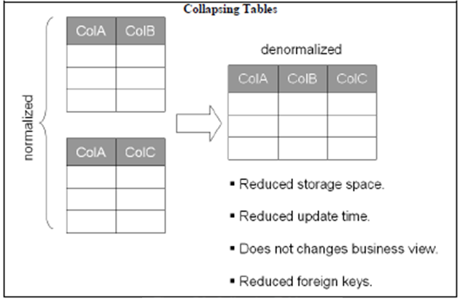
Five principal De-Normalization techniques
Data Warehousing

Slide 23
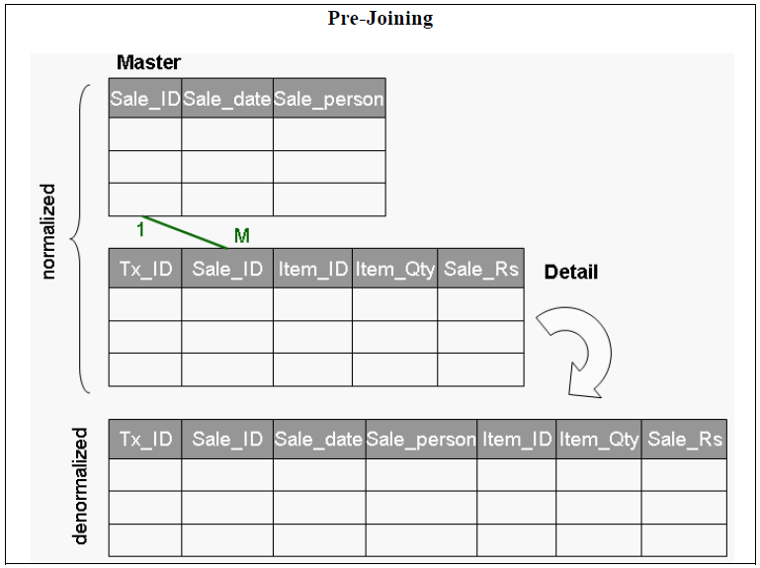
Five principal De-Normalization techniques
Pre-joining
  The objective behind pre-joining is to identify frequent joins and append the corresponding tables together in the physical data model.
  This technique is generally used when there is a one-to-many relationship between two (or more) tables
Data Warehousing

Slide 24
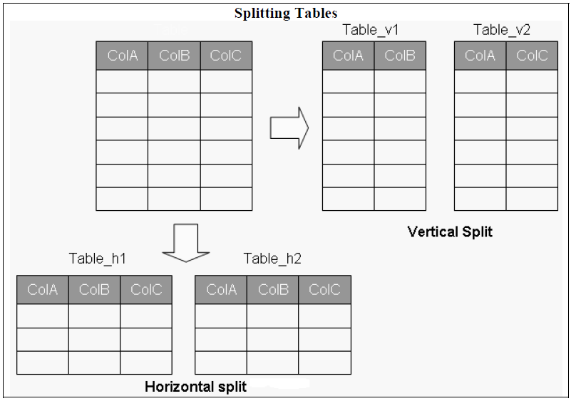
Five principal De-Normalization techniques
Splitting Tables
  Denormalization can be used to create more tables by splitting a relation into multiple tables.
  Both horizontal and vertical splitting and their combination are possible.
  This form of denormalization - record splitting- is especially common for a distributed DSS environment.
Data Warehousing

Slide 25
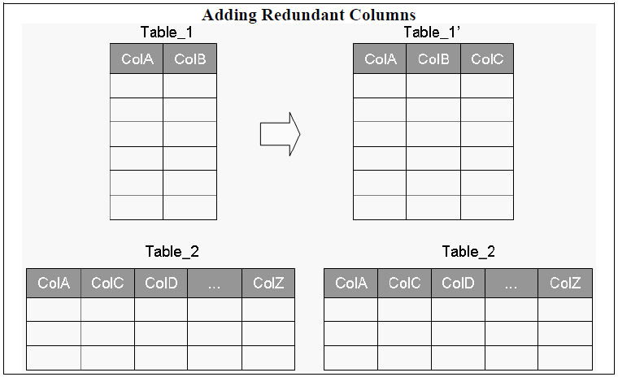
Five principal De-Normalization techniques
Adding Redundant Columns
  This technique can be used when a column from one table is frequently accessed in a large scale join in conjunction with a column from another table.
  To avoid this join, the column is added (redundant) or moved into the detail table(s) to avoid the join.
Data Warehousing

Slide 26
Five principal De-Normalization techniques
Derived Attributes
  It is usually feasible to add derived attribute(s) in the data warehouse data model, if the derived data is frequently accessed and calculated once and is fairly stable.
  The justification of adding derived data is simple; it reduces the amount of query processing time at run-time while accessing the data in the warehouse.
  Furthermore, once the data is properly calculated, there is little or no worry about the authenticity of the calculation.
  Put in other words, once the derived data is properly calculated it kind of becomes absolute i.e. there is hardly any chance that someone might use a wrong formula to calculate it incorrectly.
  This actually enhances the credibility of the data in the data warehouse.
Data Warehousing

Slide 27
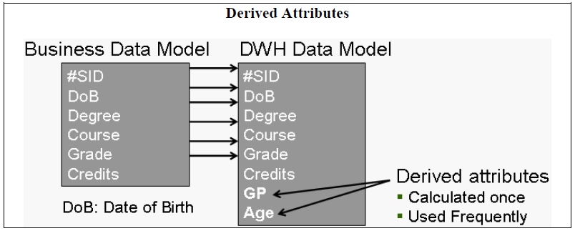
Five principal De-Normalization techniques
Data Warehousing

Slide 28
Issues of De-Normalization
The effects of denormalization on database performance are unpredictable: as many applications/users can be affected negatively by denormalization when some applications are optimized.
If a decision is made to de-normalize, make sure that the logical model has been fully normalized to 3NF.
Also document the pure logical model and keep your documentation of the physical model current as well.
Consider the following list of effects of denormalization before you decide to undertake design changes.
Data Warehousing

Slide 29
Issues of De-Normalization
The trade-offs of denormalization are as follows:
  Storage
  Performance
  Ease-of-use
  Maintenance
Data Warehousing

